Slide 1
Manuscript Figures

Slide 2
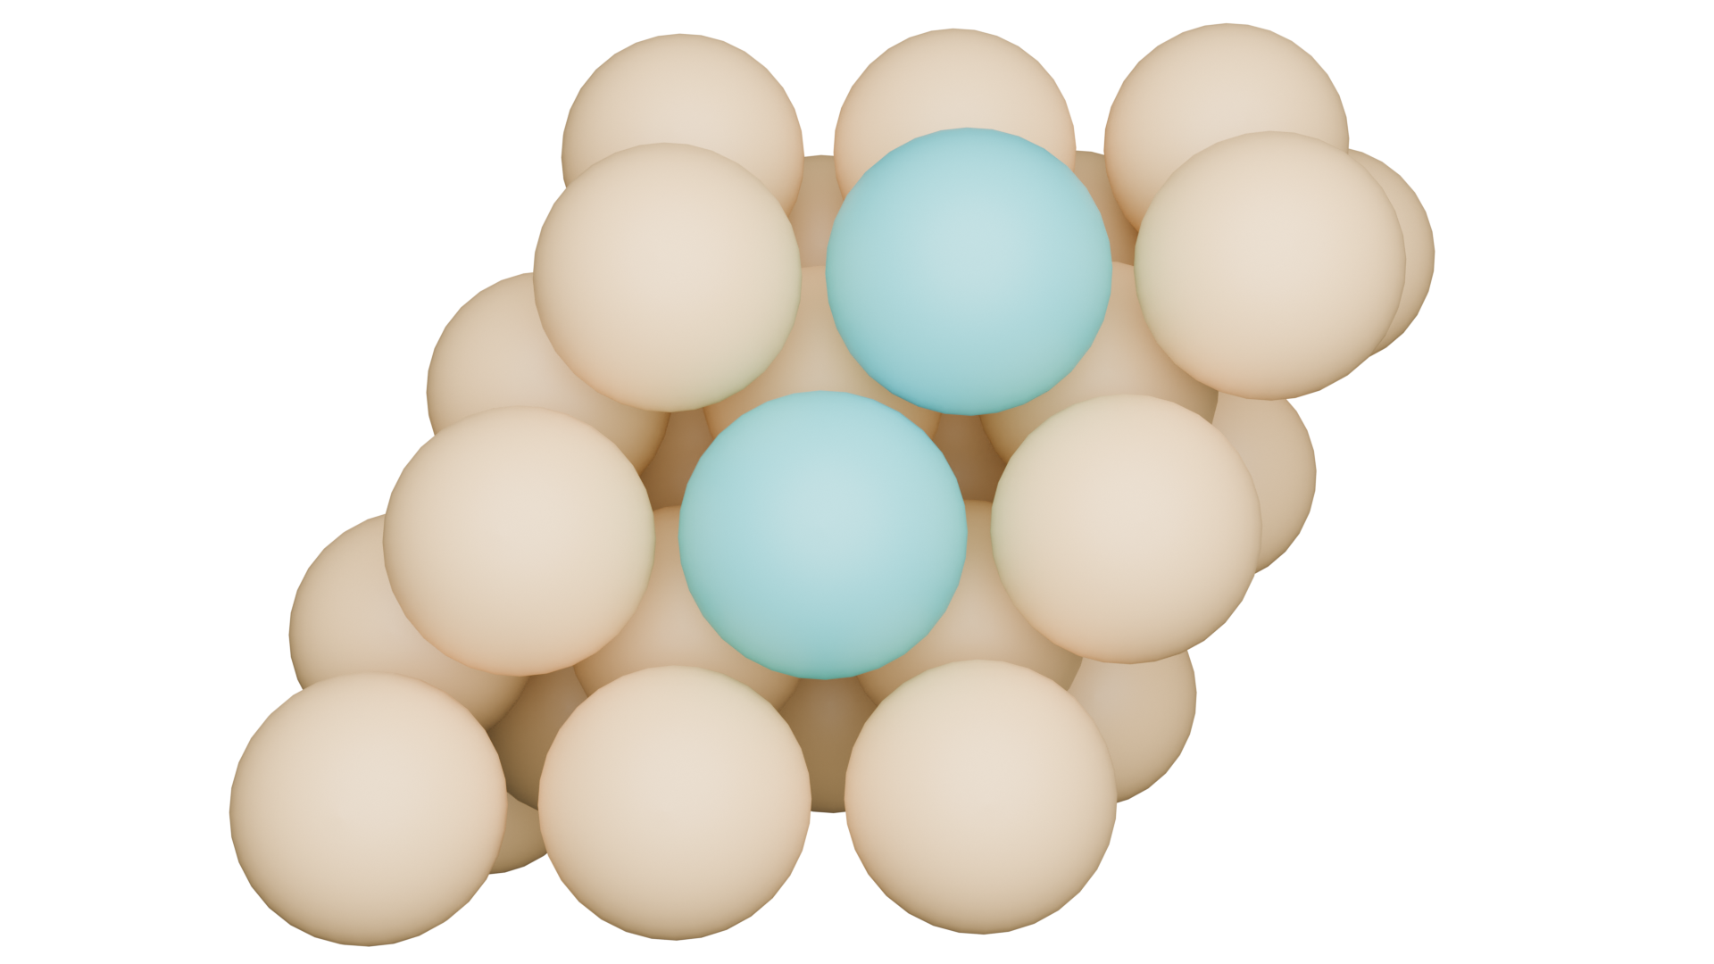
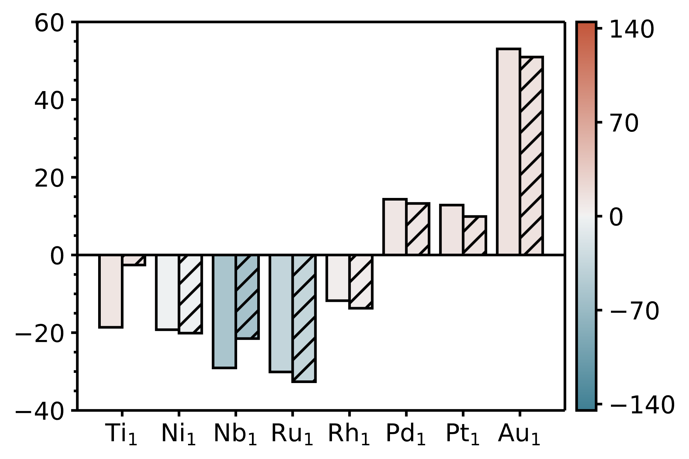
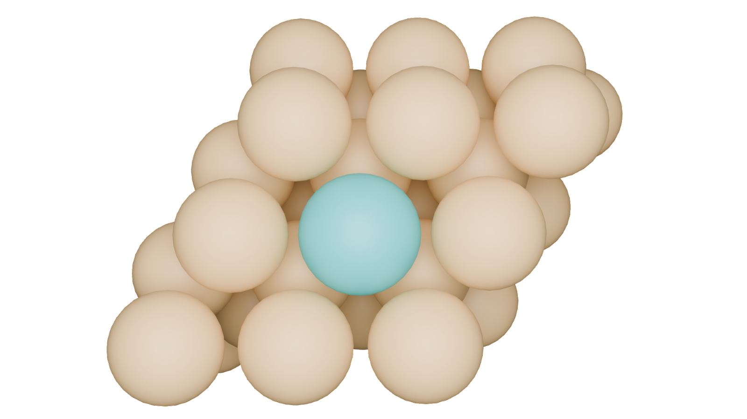
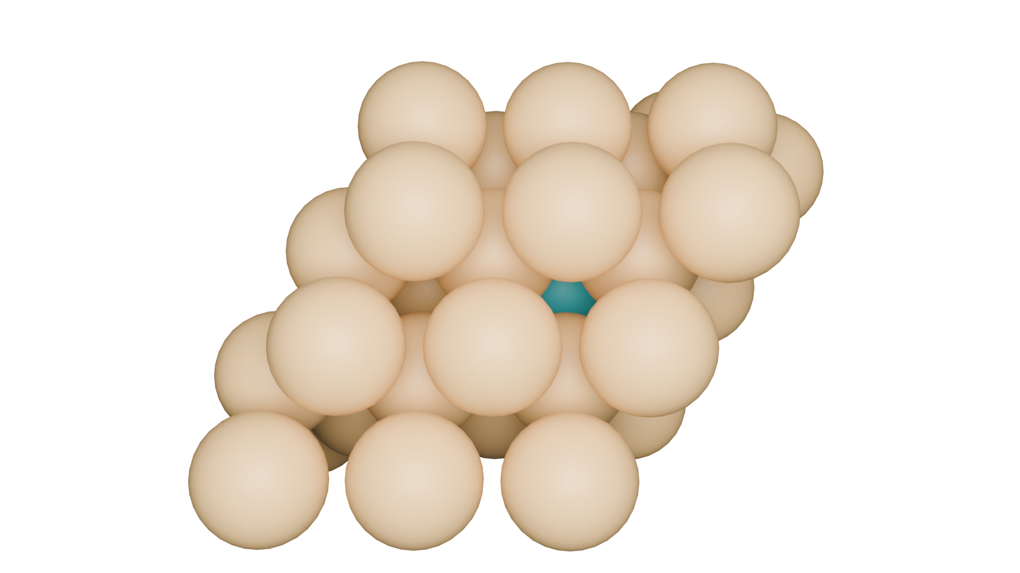
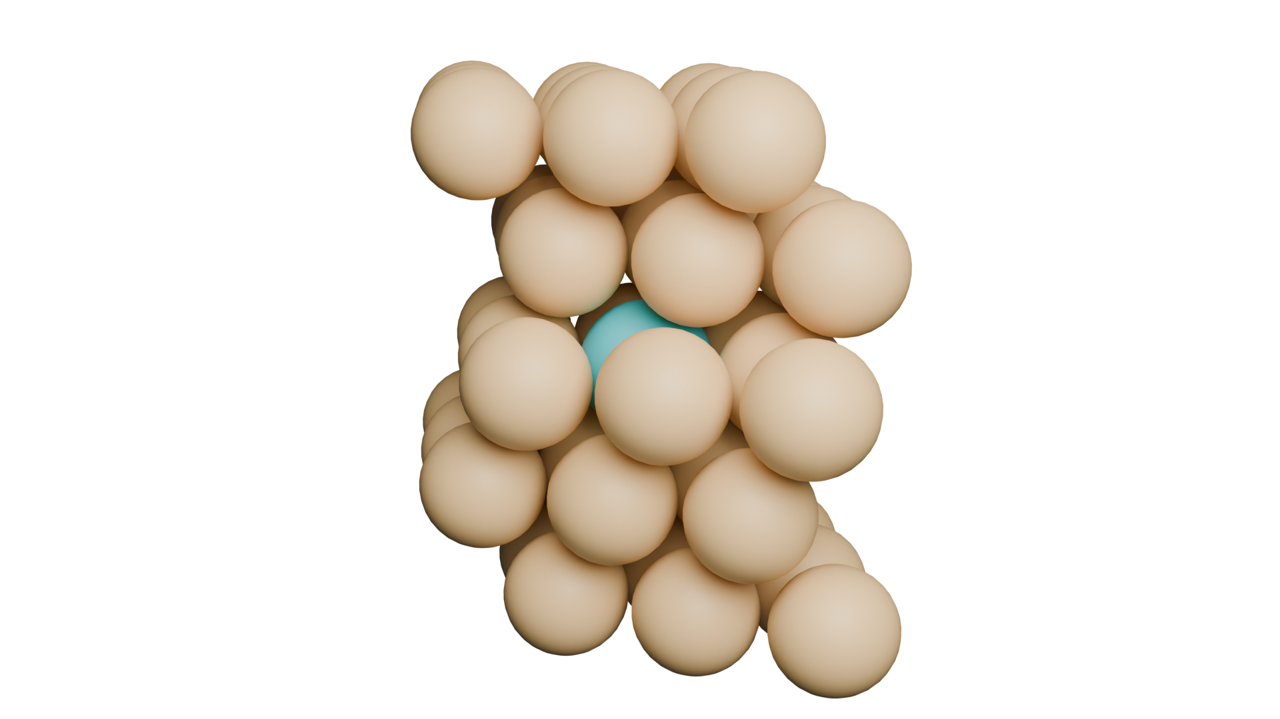
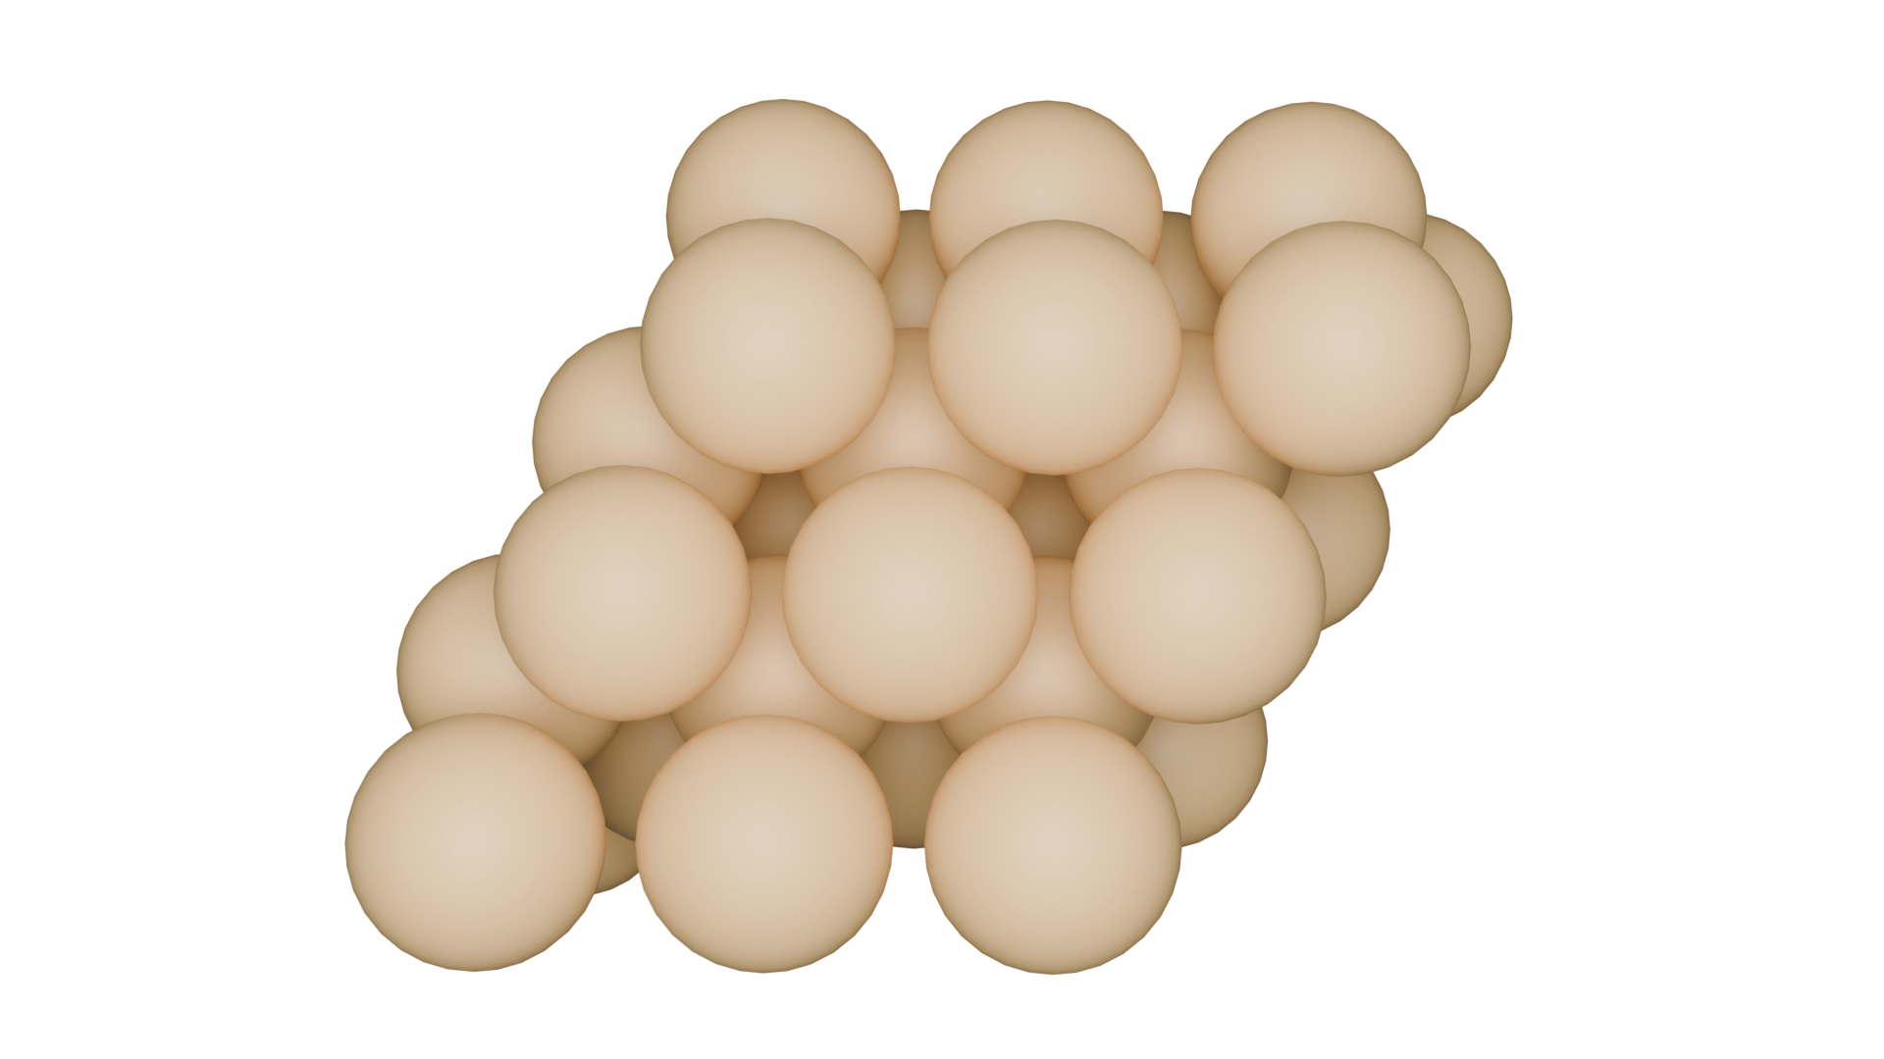

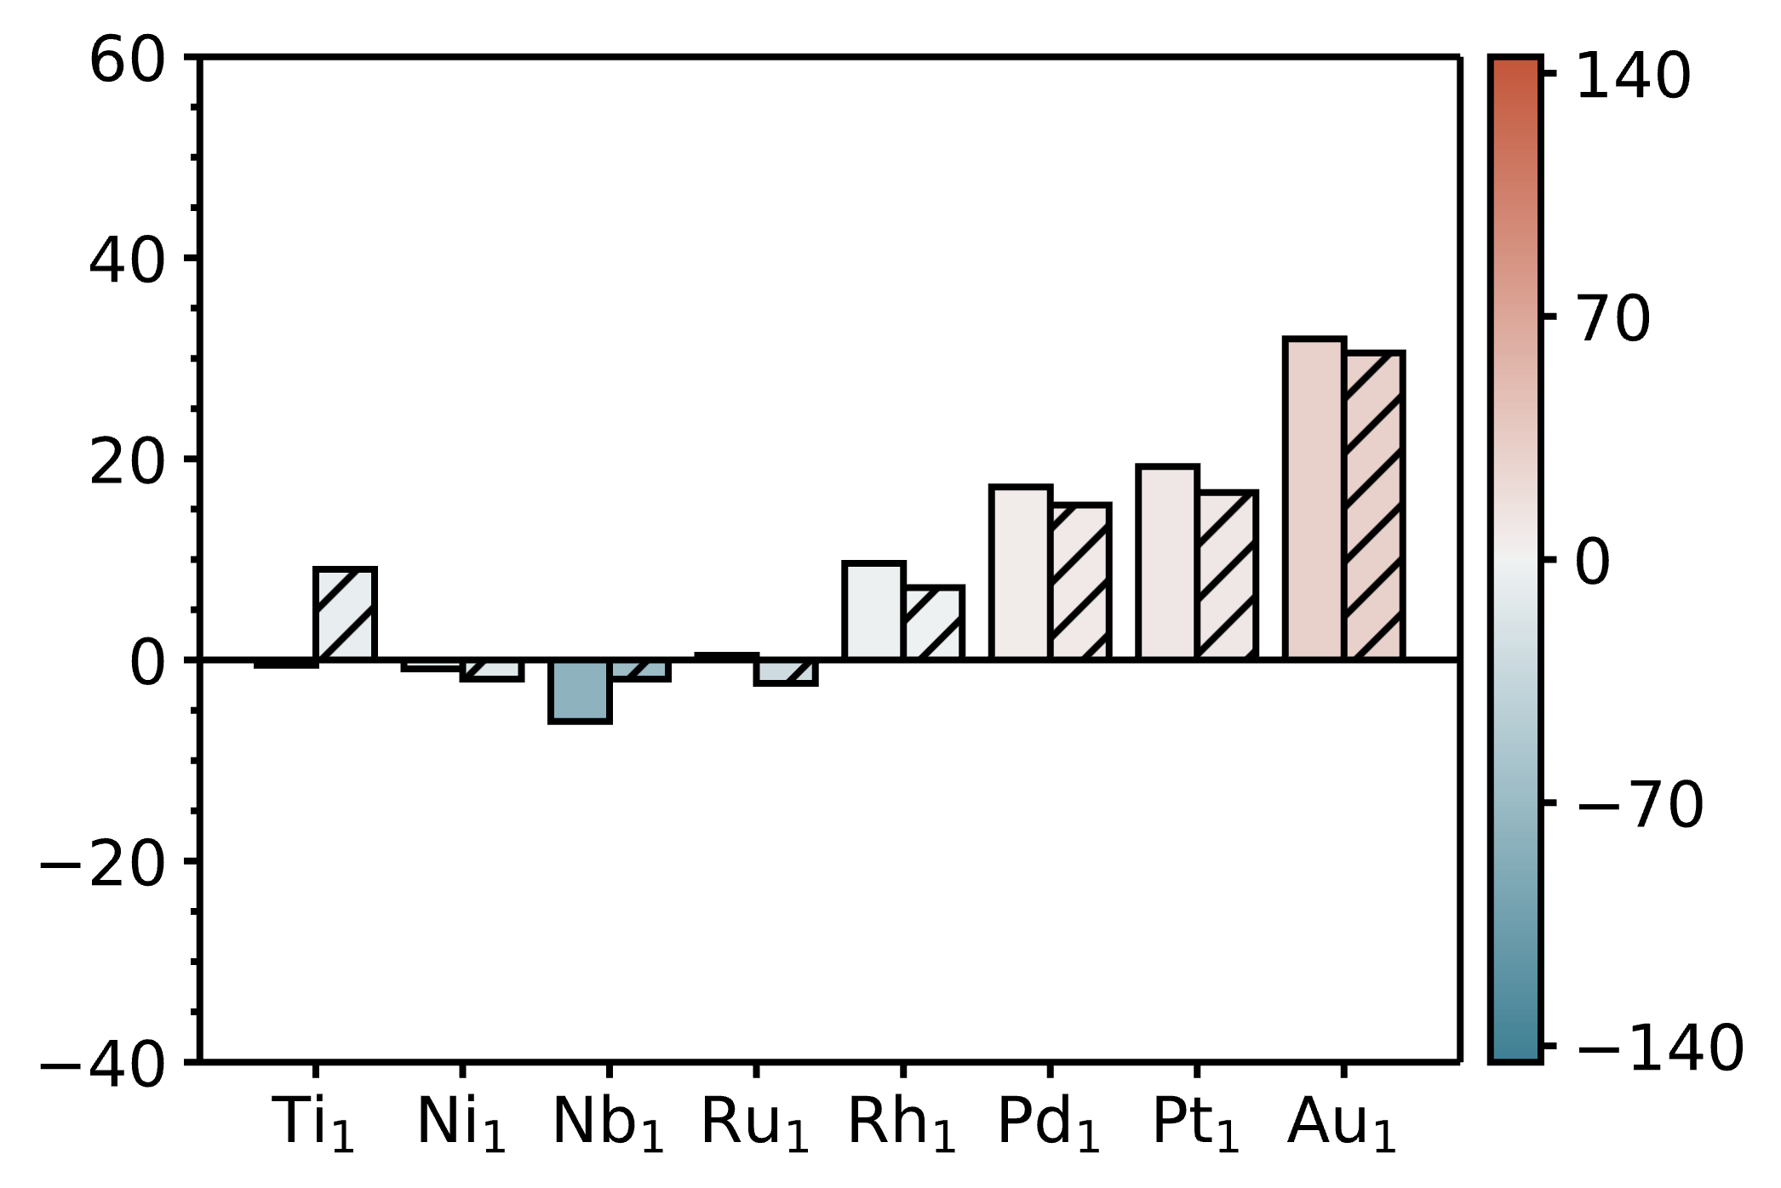
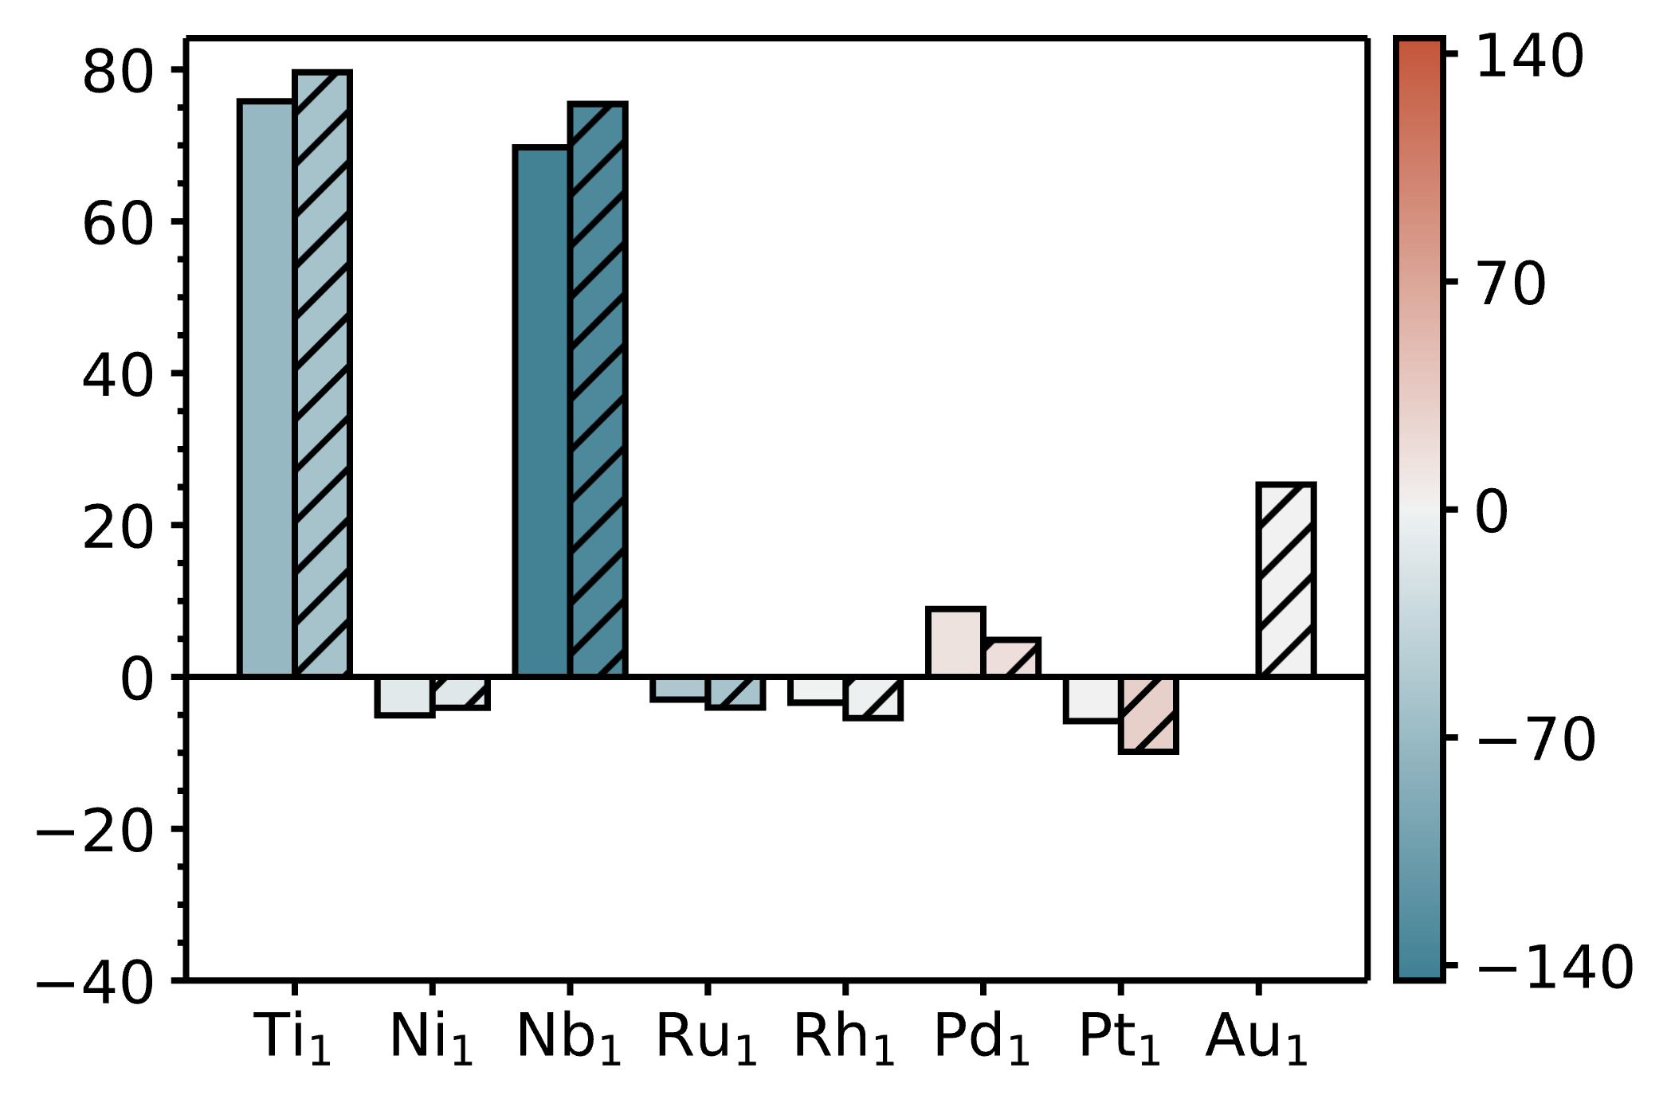
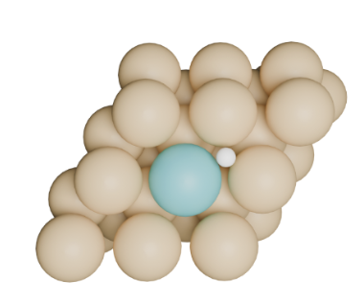
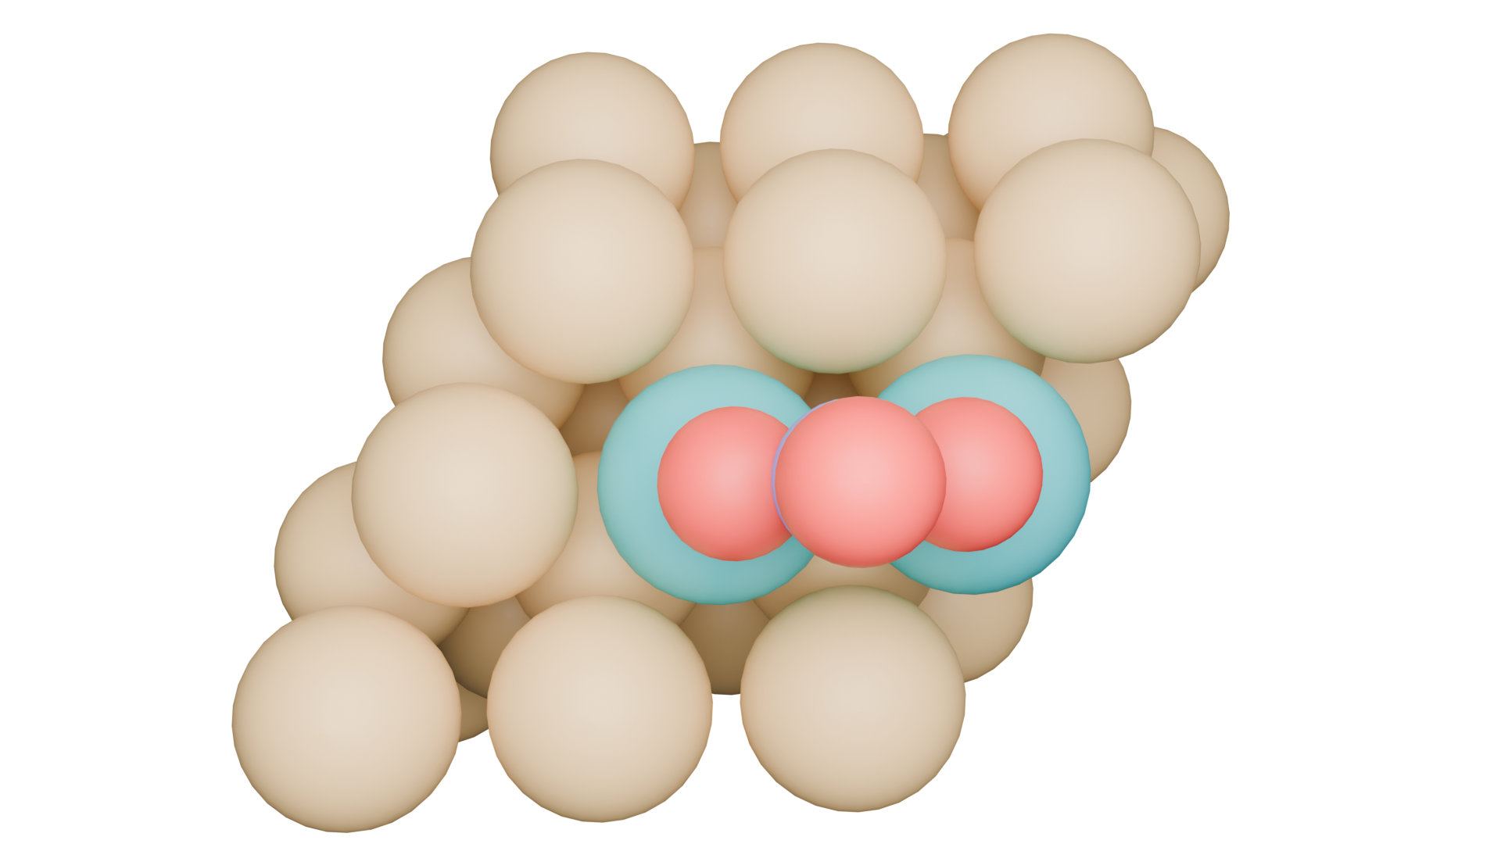
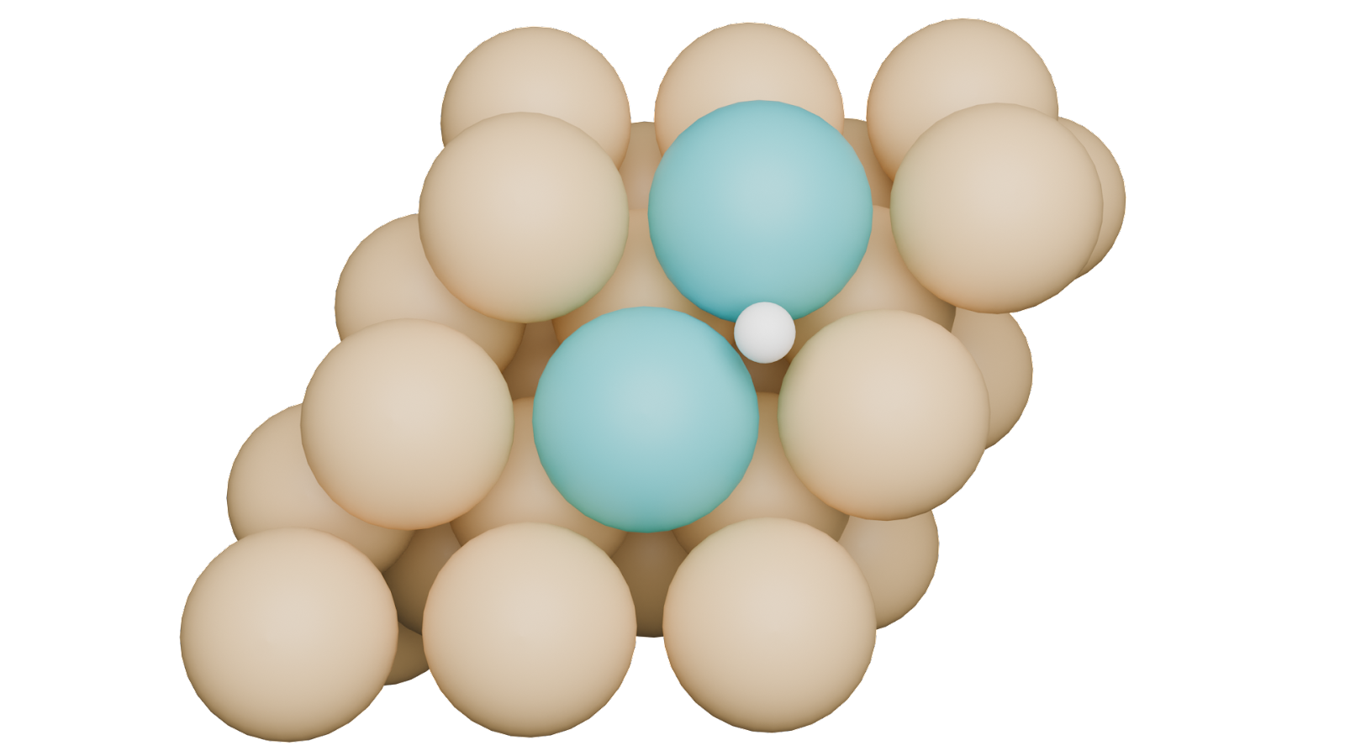
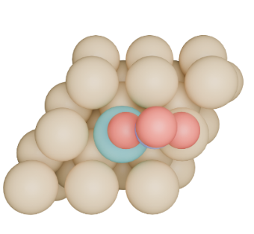
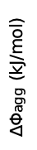
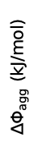
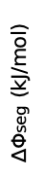

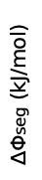


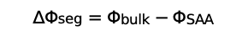
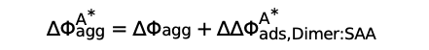

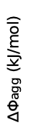
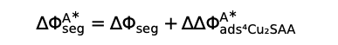
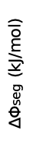
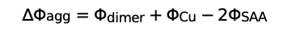
(a)
(b)
$∆Φ_{seg}=Φ_{bulk}−Φ_{SAA}$
Bare
Top view
Side view
Dopant
$$∆Φ_{seg}$$
Host
$∆Φ_{agg}$ (kJ/mol)
$∆Φ_{seg}$ (kJ/mol)
$$∆Φ_{agg}=Φ_{dimer}+Φ_{Cu}−{2Φ}_{SAA}$$
$$+$$
$$∆Φ_{agg}$$
$$+$$
$$∆Φ_{seg}^{A^{∗}}={∆Φ_{seg}+∆∆Φ}_{ads, Cu:SAA}^{A^{∗}}$$
Adsorbate
effects
$$∆Φ_{agg}^{A^{∗}}=∆Φ_{agg}+{∆∆Φ}_{ads, Dimer:SAA}^{A^{∗}}$$
(c)
A* = H*
(d)
A* = NO₃*
$∆Φ_{seg}$ (kJ/mol)
$∆Φ_{agg}$ (kJ/mol)
$∆Φ_{agg}$ (kJ/mol)
$∆Φ_{seg}$ (kJ/mol)

Slide 3
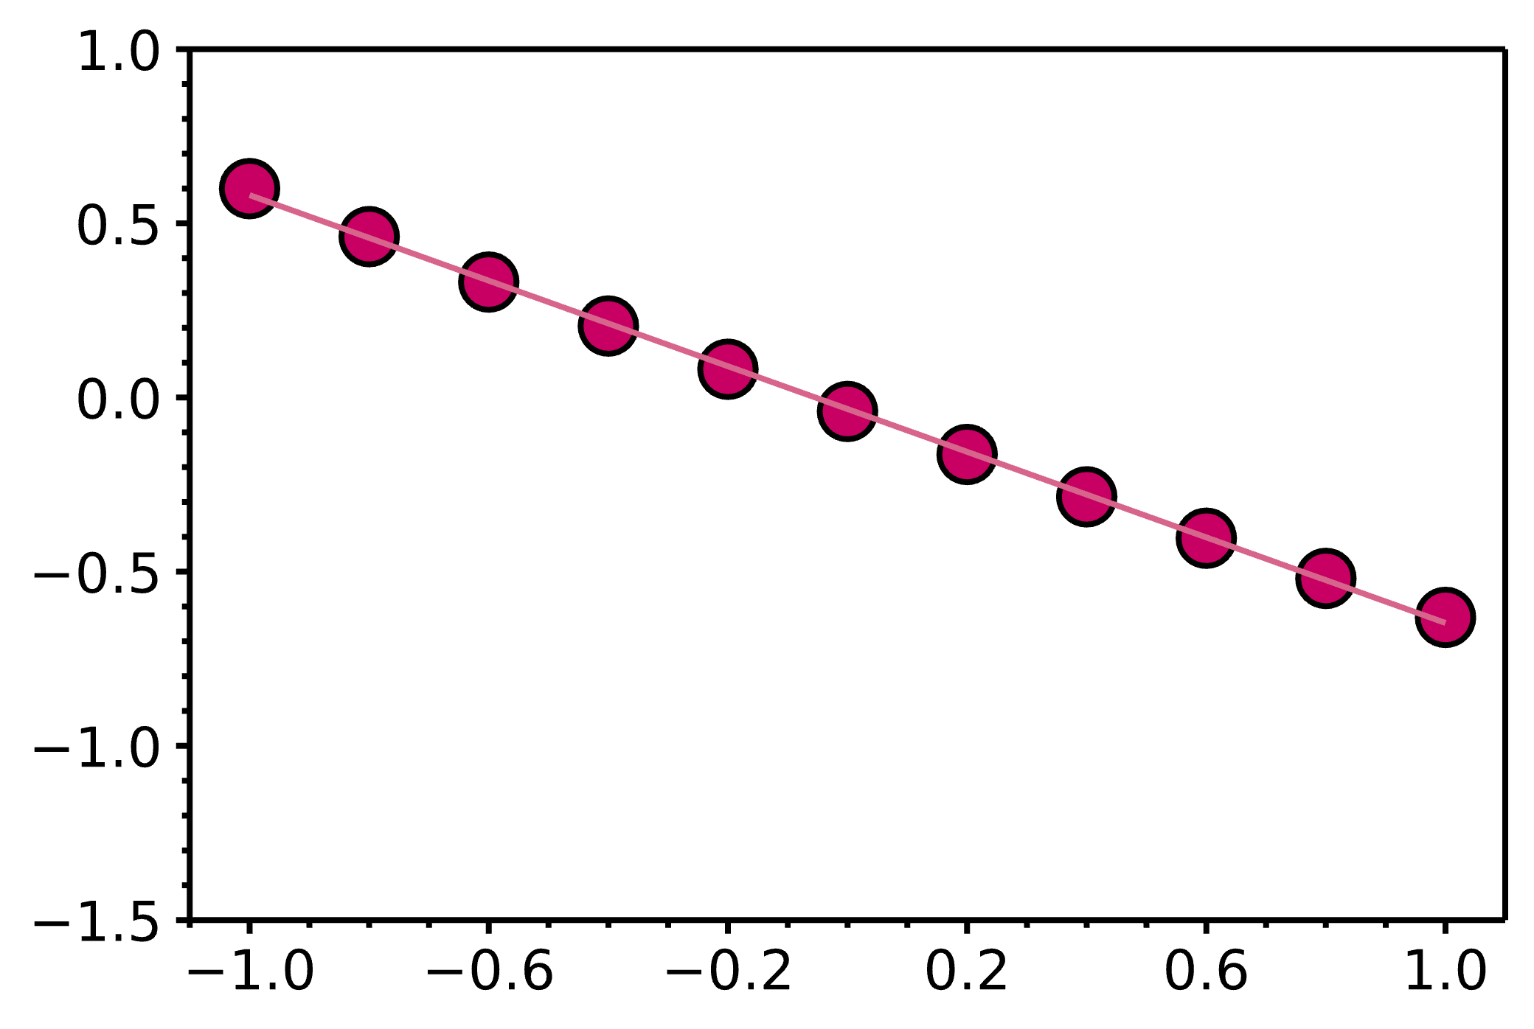
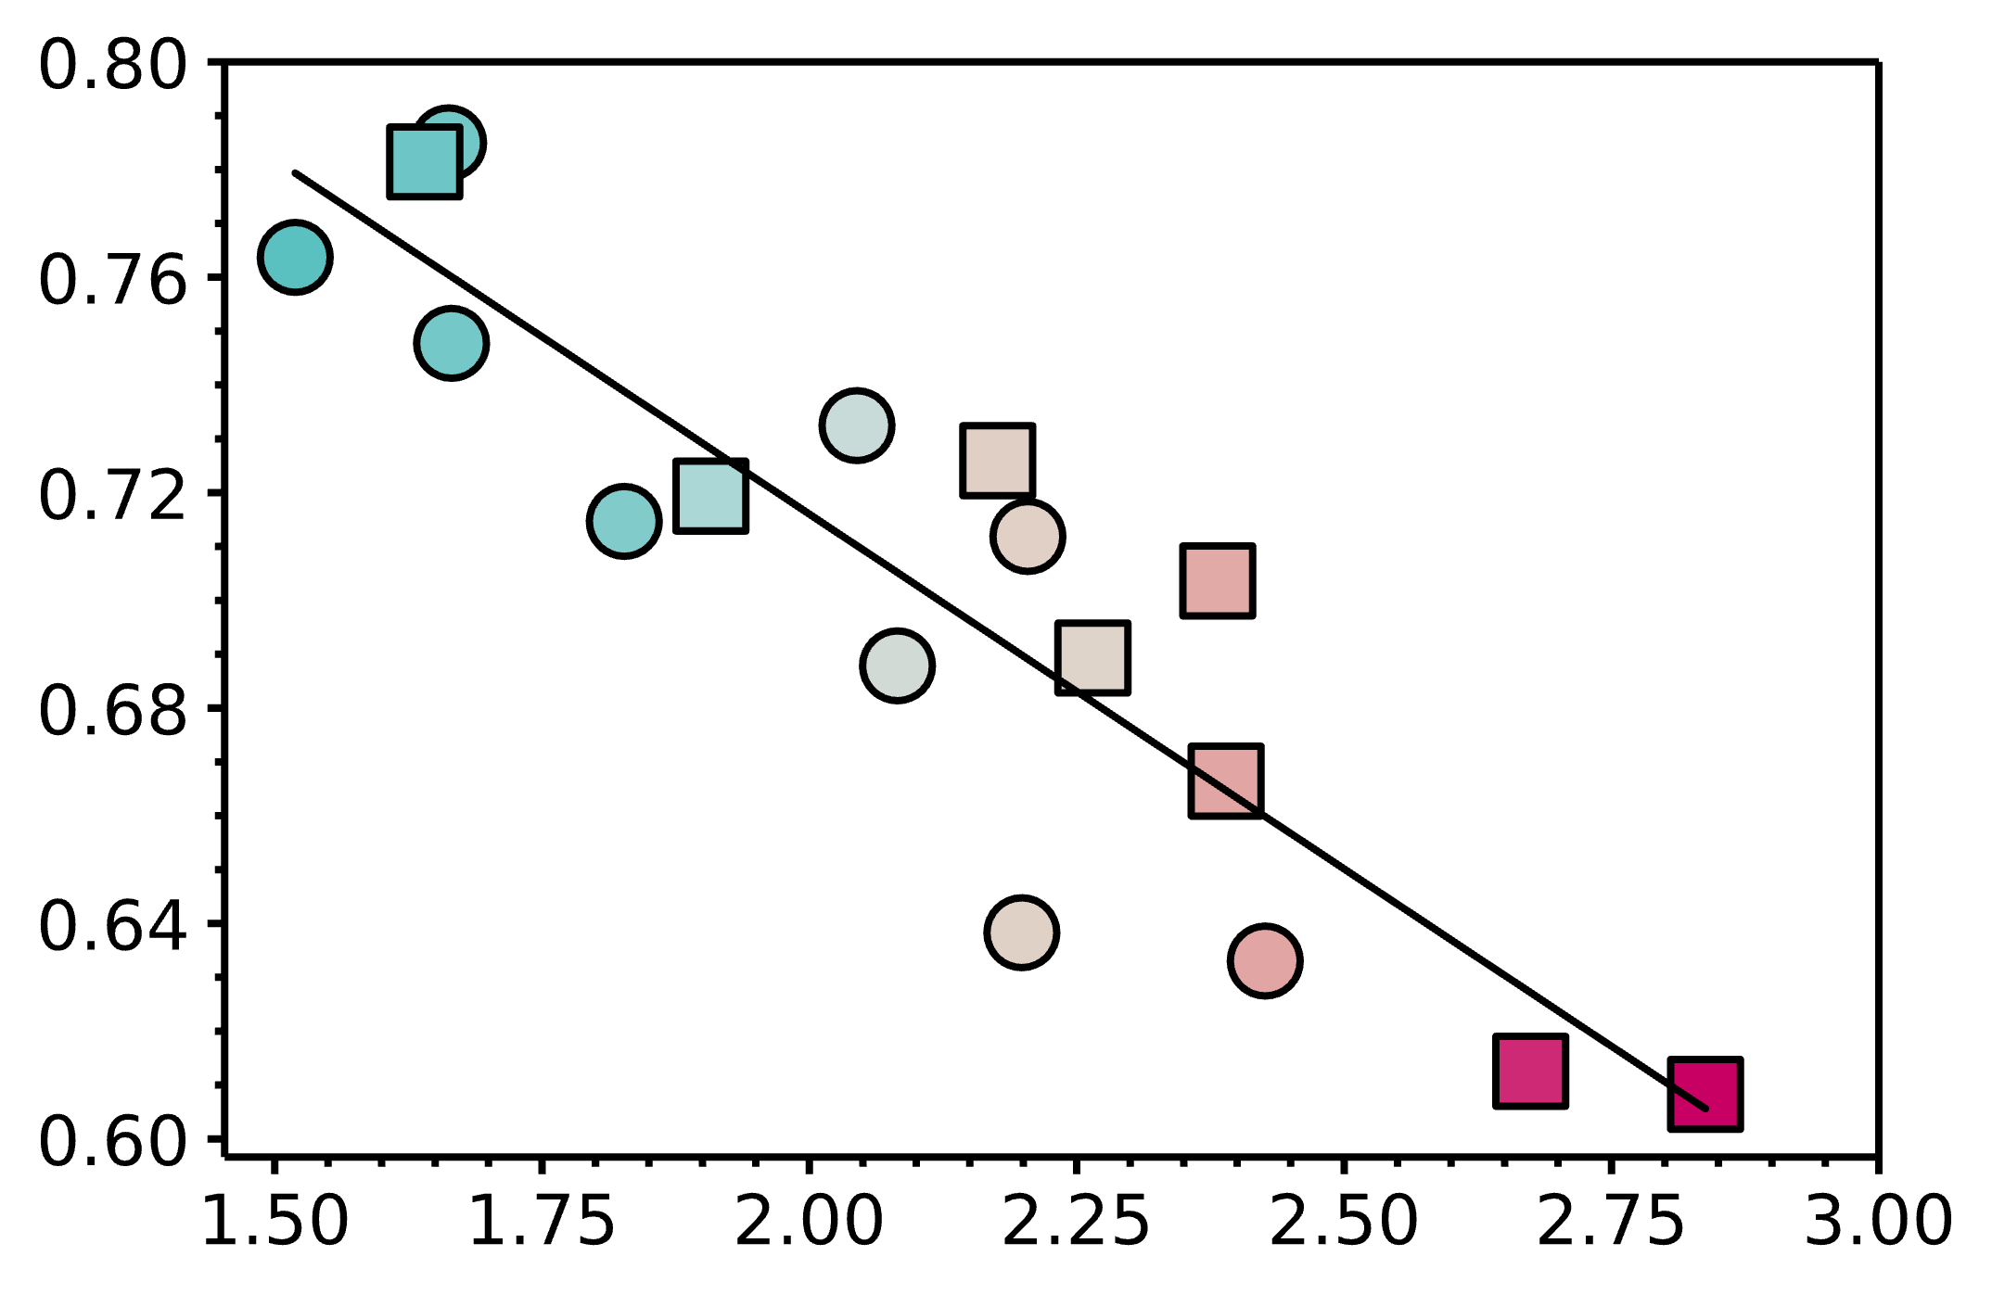
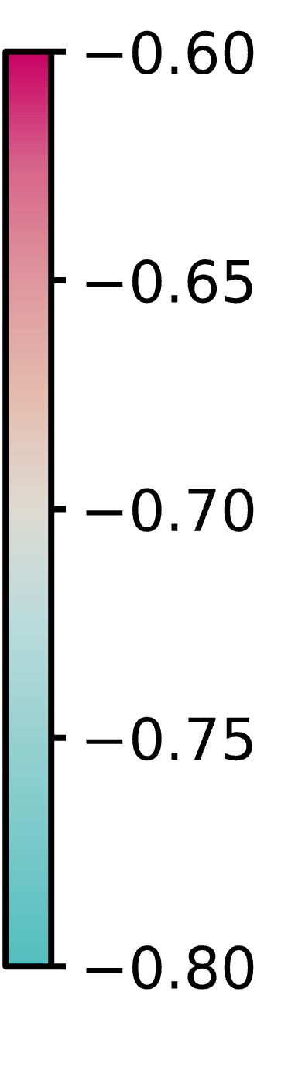
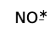
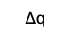

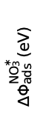

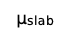

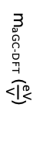
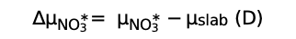

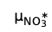
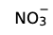

(a)
$$NO_{3}^{−}$$
$$NO_{3}^{∗}$$
(b)
$$μ_{{NO}_{3}^{∗}}$$
$$μ_{slab}$$
$$∆q$$
Rh
$${∆q}_{{NO}_{3}^{∗}}=−0.13{∆μ}_{{NO}_{3}^{∗}}+0.98$$
m_{eGC-DFT} $=−0.61\frac{eV}{V}$, R²=1.00
Rh
R²=0.80
Ru
Ru₁
Ru₁
Ni
$$∆Φ_{ads}^{NO_{3}^{∗}}(eV)$$
Rh₁
$${∆q}_{{NO}_{3}^{∗}}= q_{NO_{3}^{∗}}−q_{NO_{3}^{−}}(e)$$
Pd
Ni
Rh₁
m_{aGC-DFT}$≈−0.69\frac{eV}{V}$
Ni₁
Pd
Ni₁
m_{aGC-DFT}$(\frac{eV}{V})$
m_{CHE} $=−1.0\frac{eV}{V}$
(111)/(0001)
Cu
Pd₁
Pd₁
(100)
Cu
Potential (V vs SHE)
$${∆μ}_{{NO}_{3}^{∗}}= μ_{NO_{3}^{∗}}−μ_{slab} (D)$$

Slide 4
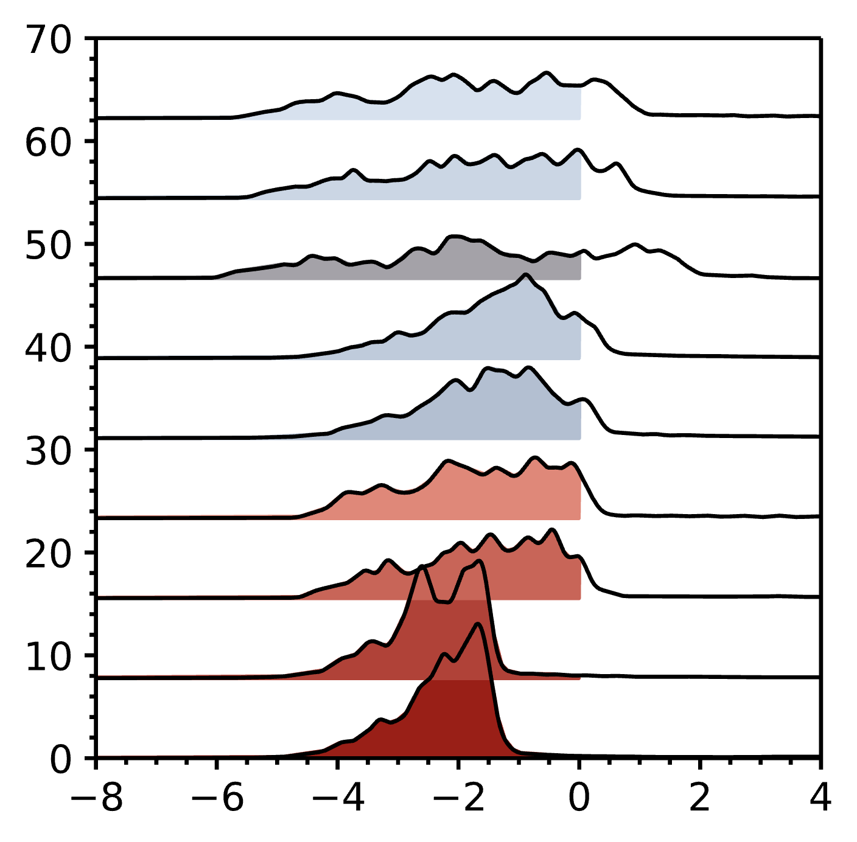
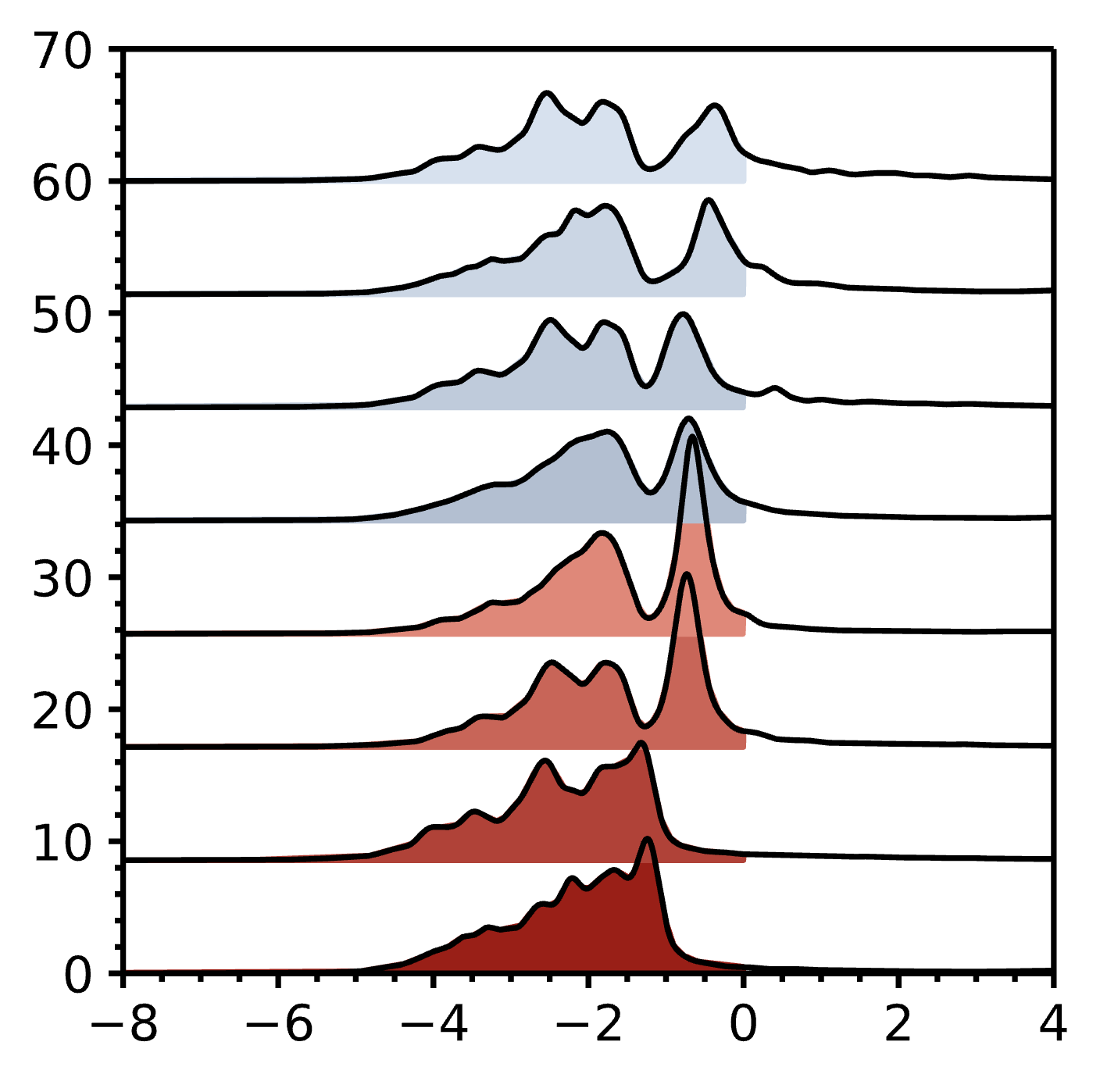
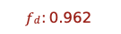




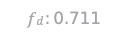










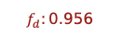


(a)
(b)
Pure Metals
Single Atom Alloys
Rh(111)
$$f_{d}:0.789$$
Ru₁(111)
$$f_{d}:0.840$$
Rh(100)
$$f_{d}:\text{0.794}$$
Ru₁(100)
$f_{d}:$ 0.844
Ru(0001)
$$f_{d}:0.711$$
Rh₁(111)
$$f_{d}:0.887$$
Ni(111)
$$f_{d}:\text{0.860}$$
Rh₁(100)
$f_{d}:$ 0.895
pDOS (arbitrary units)
$$f_{d}:\text{0.867}$$
Increasing charge transfer
Ni(100)
Ni₁(111)
$$f_{d}:0.915$$
Pd(111)
$$f_{d}:0.906$$
Pd(100)
$$f_{d}:0.911$$
Ni₁(100)
$$f_{d}:0.921$$
Cu(111)
$$f_{d}:0.956$$
Pd₁(111)
$$f_{d}:0.930$$
Cu(100)
$$f_{d}:0.962$$
Pd₁(100)
$$f_{d}: 0.938$$
$$ε−ε_{fermi}$$
$$ε−ε_{fermi}$$

Slide 5
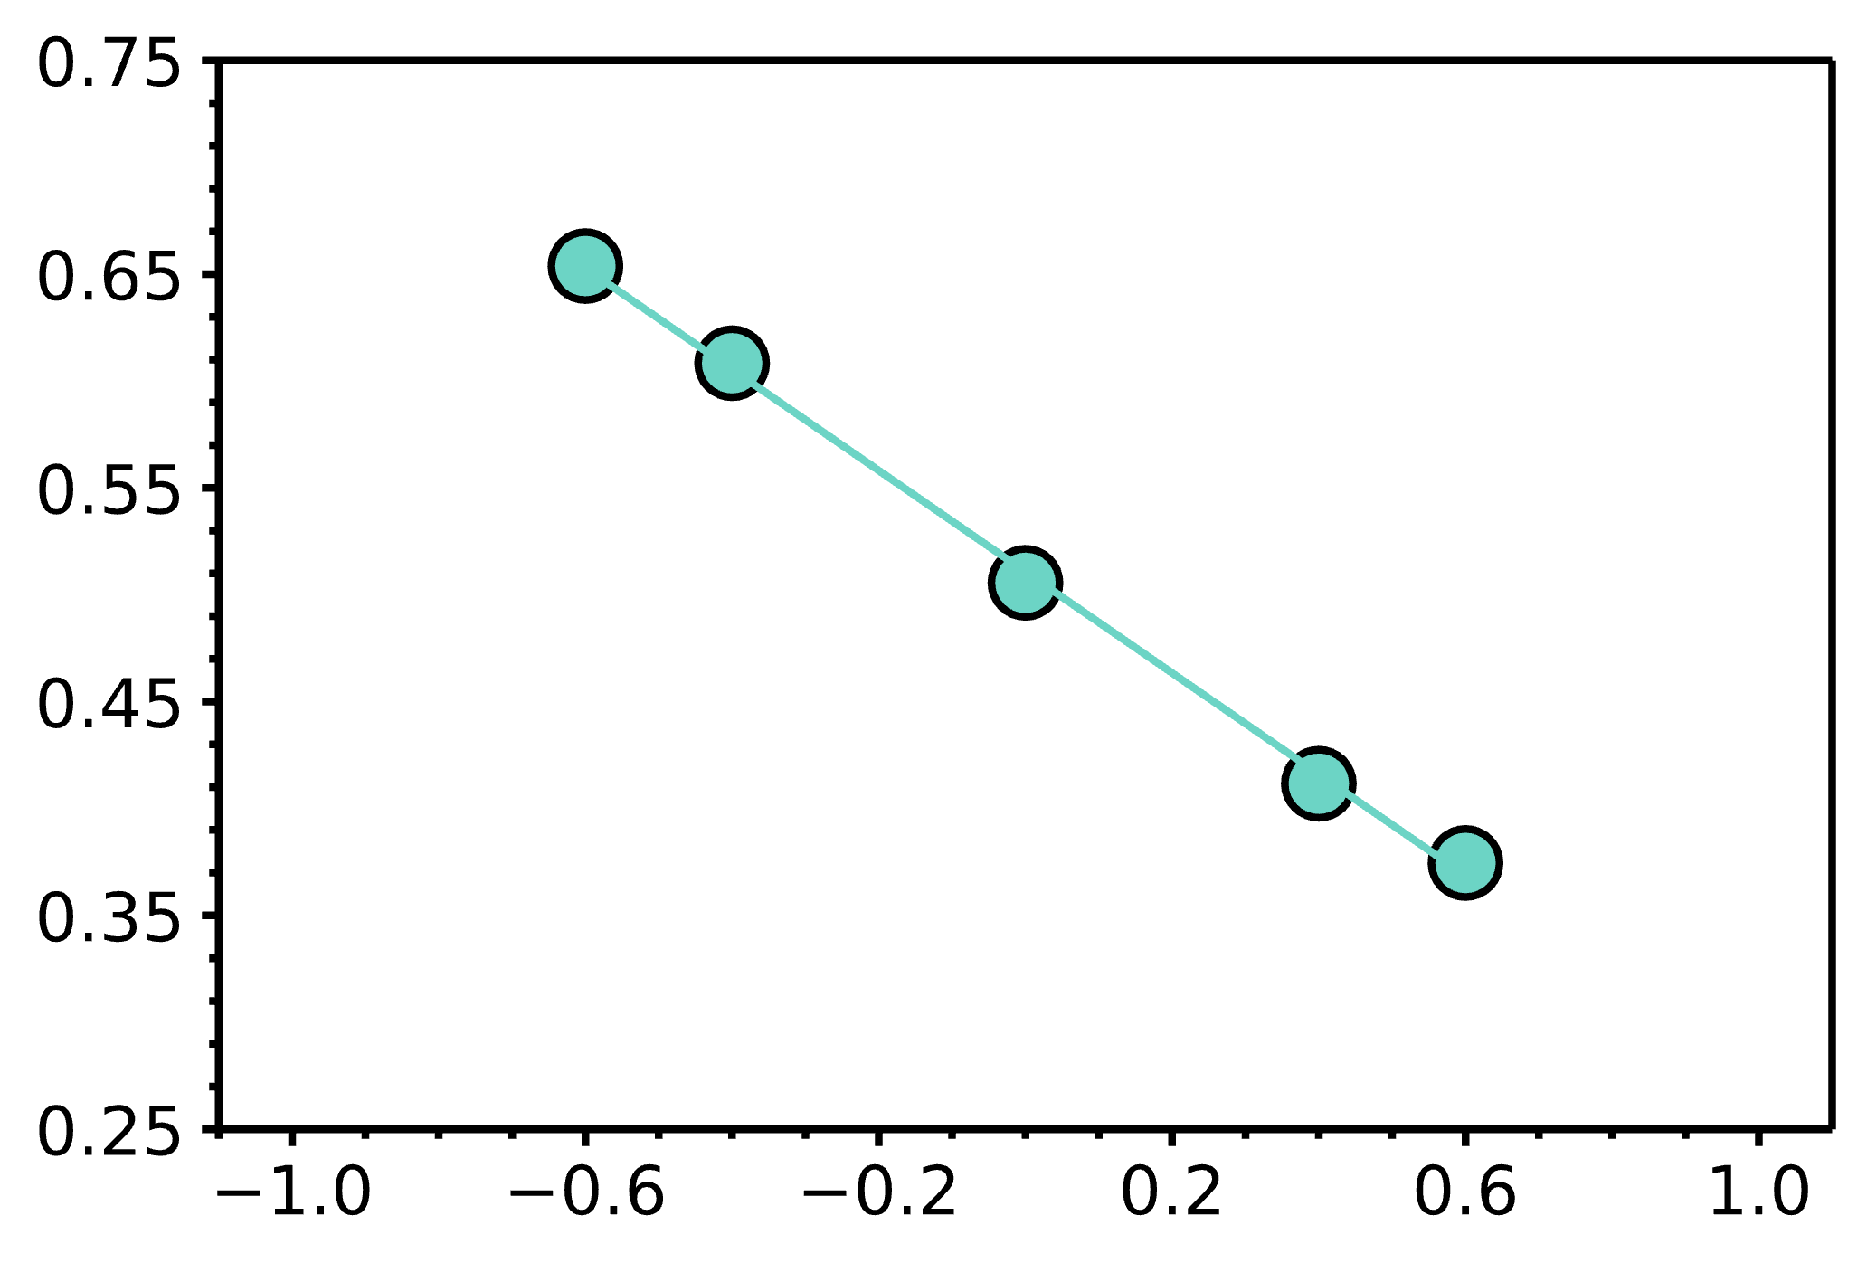
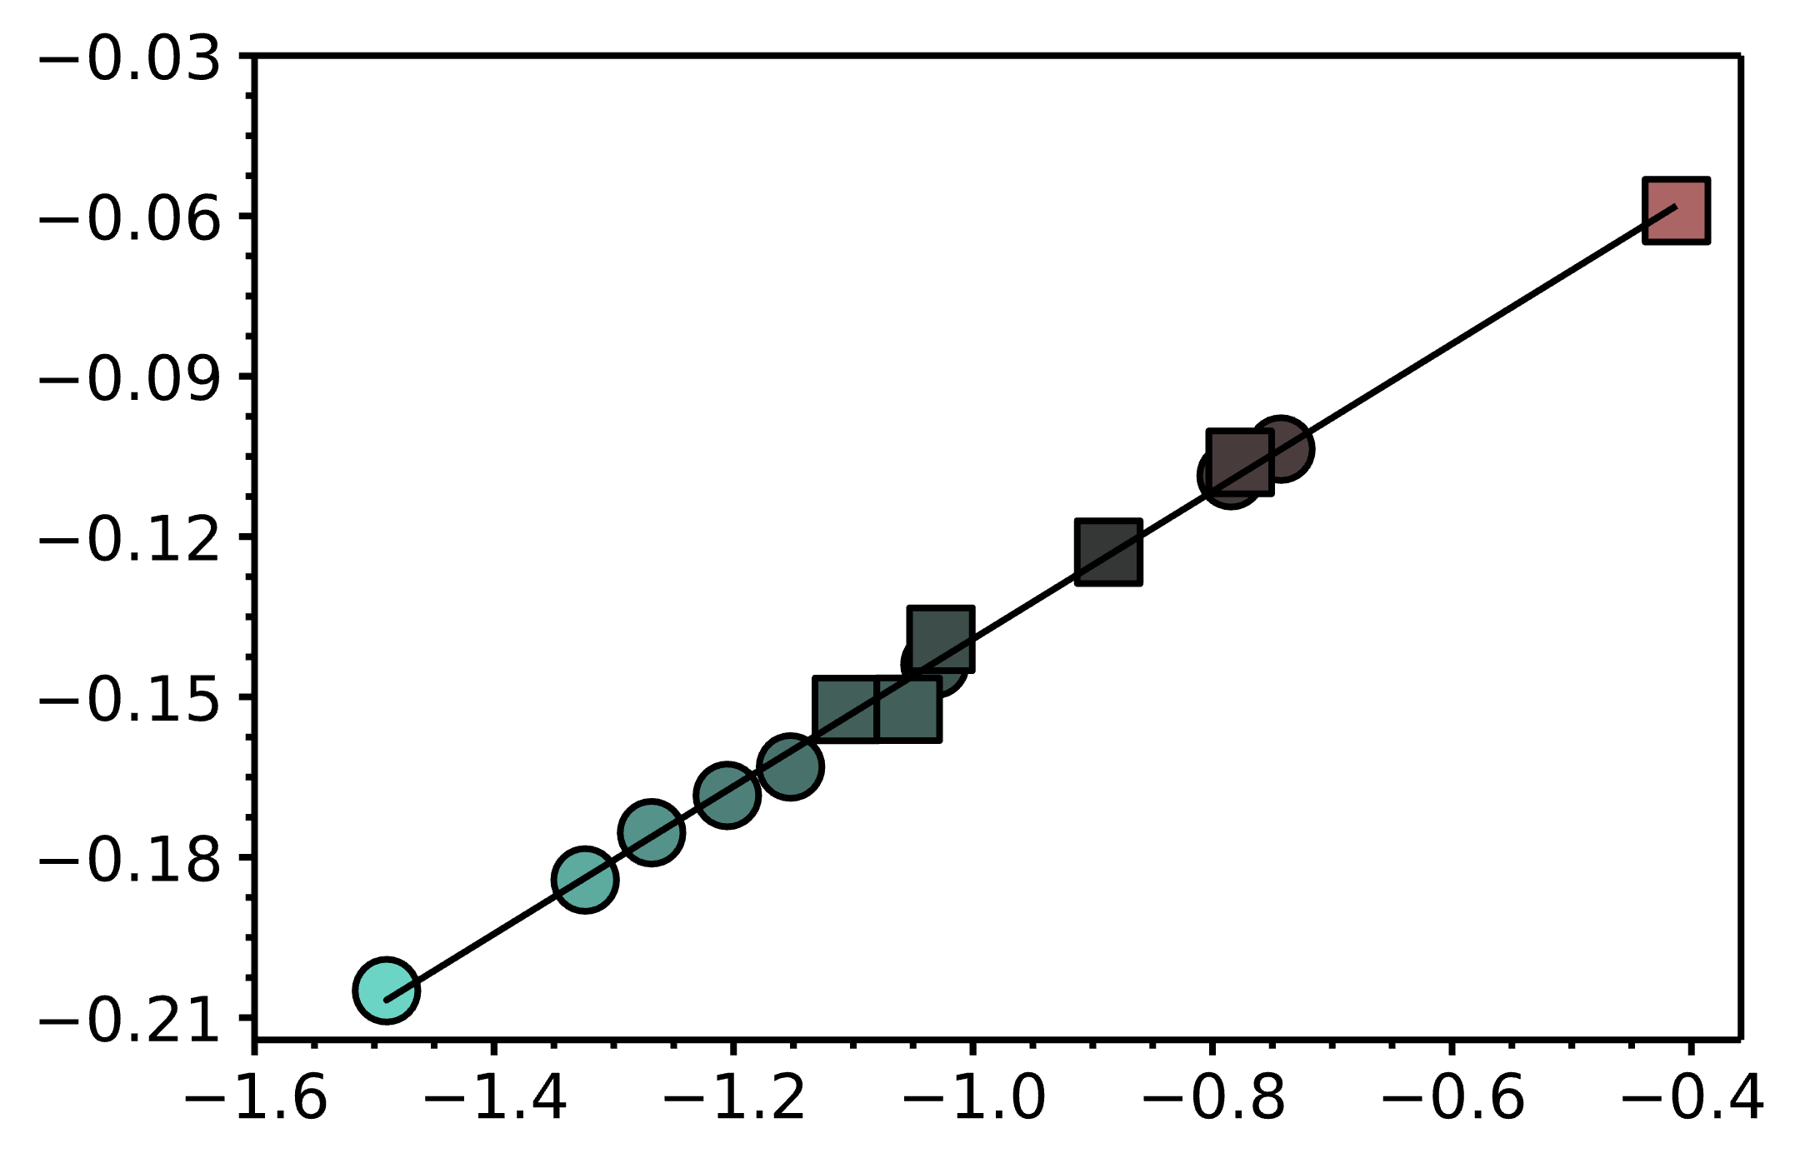
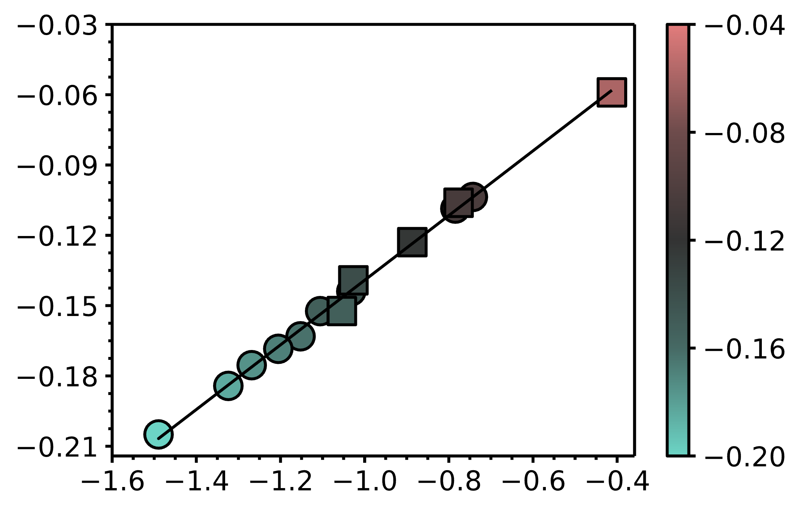

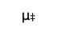












$$Φ_{‡}$$
$$Φ_{{NO}_{3}^{∗}}$$
$$∆Φ^{‡}$$
$$Φ_{NO_{2}^{∗}+ O^{∗}}$$
$$μ_{‡ }$$
$$μ_{{NO}_{3}^{∗}}$$
(a)
(b)
m_{eGC-DFT} $≈$ $−0.23\frac{eV}{V}$, R²=0.99
$$\text{m}\text{aGC}\text{−}\text{DFT}=0.13{∆μ}_{‡}−0.002$$
Rh
R²=1.00
Ru₁
m_{null}= $0.0\frac{eV}{V}$
m_{aGC-DFT}$(\frac{eV}{V})$
Rh₁
Ru₁
m_{aGC-DFT}$(\frac{eV}{V})$
$$∆Φ^{‡} (eV)$$
Ni₁
Rh₁
Cu
Rh
Ru
Pd
Pd
Ni₁
Cu
m_{aGC-DFT} $≈$ $−0.17\frac{eV}{V}$
Pd₁
(111)/(0001)
(100)
Potential (V vs SHE)
$${∆μ}_{‡ }={μ_{‡ }−μ}_{NO_{3}^{∗}} (D)$$

Slide 6















(a)
(b)
$U_{min}≈U_{0}+\frac{3}{4εA}(μ_{NO_{3}^{∗}}+μ_{∗}$)
$|∆Φ_{aGC−DFT}−∆Φ_{CHE}|$ (kJ/mol)
$$ε_{r}$$
$|∆Φ_{aGC−DFT}−∆Φ_{CHE}|$ (kJ/mol)
Ni₁Cu (111)
$$U_{min}$$
d (Å)
(c)
(d)
$U_{min}≈U_{0}+\frac{3}{4εA}(μ_{NO_{3}^{∗}}+μ_{‡}^{ }$)
$$ε_{r}$$
$|∆Φ_{aGC−DFT}−∆Φ_{Null}|$ (kJ/mol)
$|∆Φ_{aGC−DFT}−∆Φ_{Null}|$ (kJ/mol)
Ni₁Cu (111)
$$U_{min}$$
d (Å)
Potential (V vs SHE)
+
+
+
+
-
-
-
-
-
-
-
+
+
+
+
+
+
+
+
+

Slide 7

Stable
Vacuum Segregation Energy (kJ/mol)
Unstable
This work
Darby et al.
Rh₁
Pt₁
Pd₁
Ni₁

Slide 8

Bader Charge (e⁻)
1
1
1
1
1
1
1

Slide 9





$$\text{m}\text{aGC}\text{−}\text{DFT}=0.13{∆μ}_{‡ }−0.002$$
$$R^{2}=0. 99$$
m_{aGC-DFT}$(\frac{eV}{V})$
(111)/(0001)
(100)
$${∆μ}_{‡ }={μ_{NO_{2}^{∗}⋯O} −μ}_{NO_{2}^{∗}} (D)$$

Slide 10








$$∆G_{0}$$
$${NO}_{3 (aq)}^{−}+H_{(aq)}^{+}+ ∗$$
$${NO}_{3 (aq)}^{∗}+H_{(aq)}^{+}+e^{−}$$
$$∆G_{1}$$
$$∆G_{3}$$
$$∆G_{2}$$
$$HNO_{3(aq)}+ ∗$$
$$HNO_{3(g)}+ ∗$$

